Slide 1
Cade’s Results

Slide 2
Questions and Objectives
Part 1: What are the top 5 highest-sentencing offenses in Texas?
-find the average sentence in years for all offense categories
-display results in a data frame and the top 5 in a bar graph
Part 2: How does murder-sentencing around the major Texas cities compare to murder-sentencing in Texas as a whole?
-look at murder sentencing in 5 Texas counties containing major cities (Harris, Dallas, Terrant, Bexar, Travis)
-obtain total count of murder offenses per county
-compare each county’s average murder sentence with Texas state average

Slide 3
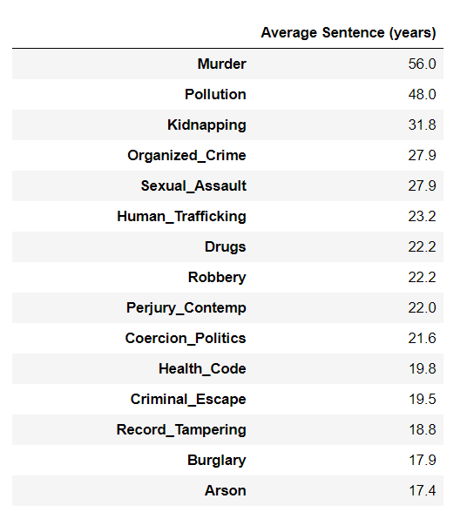
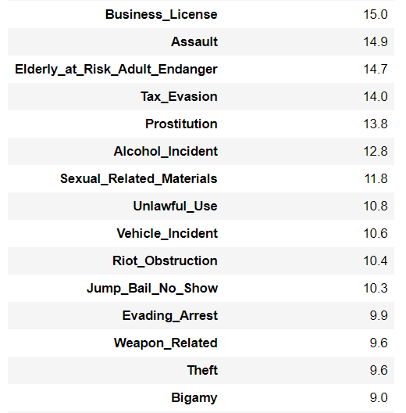
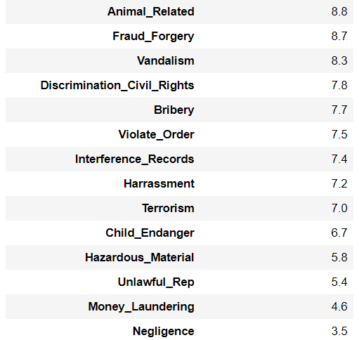
Part 1: Final Data Frame

Slide 4
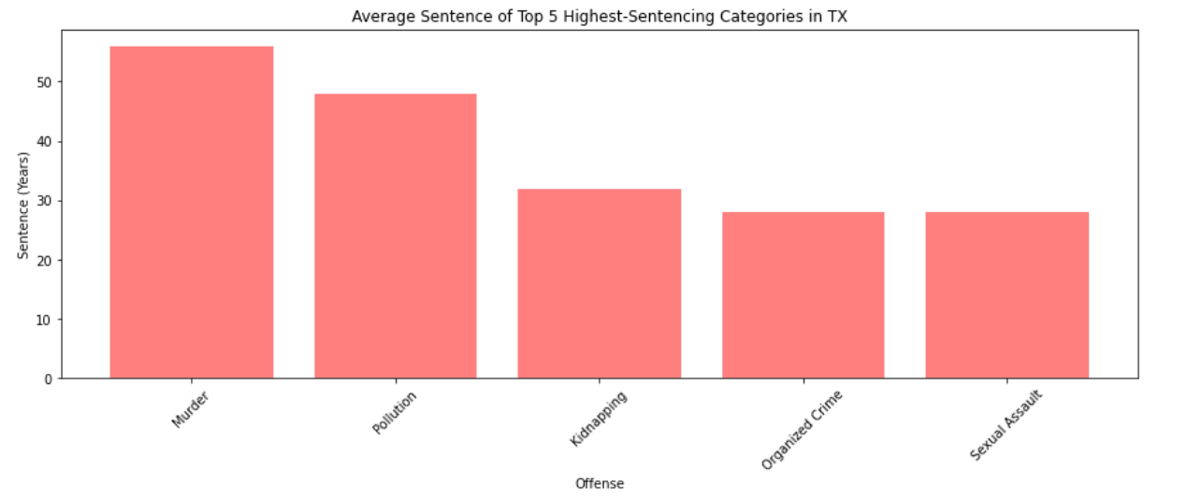
Part 1: Top 5 Highest-Sentencing Offenses in Texas

Slide 5
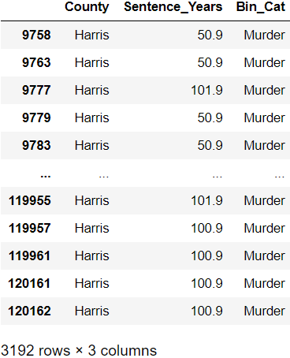
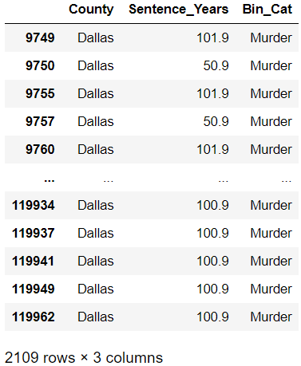
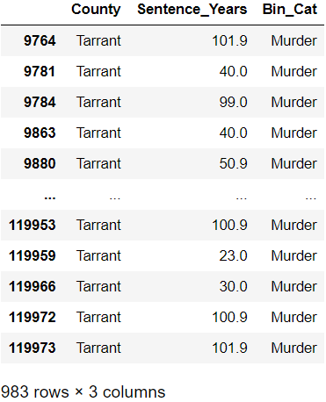
Part 2: Major County Data Frames

Slide 6
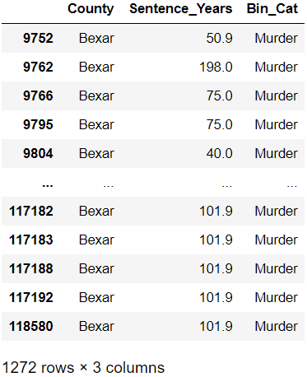
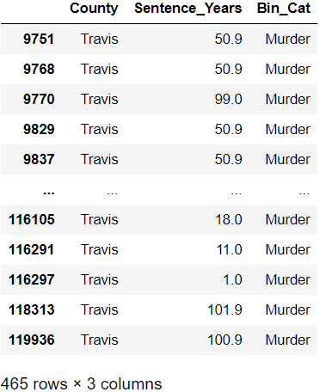

Slide 7
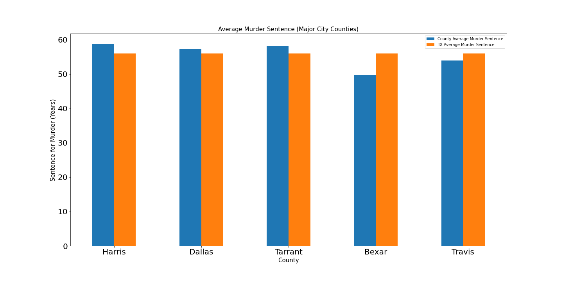
Part 2: Murder Sentencing Averages (Major Counties vs. Texas)

